Slide 1
SKILLSCOREAI
STUDENT PERFORMANCE ANALYZER

Slide 2

PRESENTED BY:
Himanshu Bind (10)
Mahek Gupta (42) Devansh Pandey (53) Akhilesh Patil (54)
Guide: Prof. S.S. Kadam

Slide 3
Skill Score AI is a machine learning-based system designed to assess and evaluate college students on a wide range of parameters such as:
Academic Performance (CGPA)
Extra-Curricular Activities
Certifications and Skills
Leadership and Experience
The system computes a final score out of 100, representing a student’s overall capabilities and achievements.
INTRODUCTION

Slide 4
ABSTRACT
Skill Score AI is a machine learning-based solution designed to provide a holistic evaluation of college students by combining academic scores, extra-curricular participation, leadership roles, and certifications.
This system evaluates students on multiple dimensions:
Academic Performance (CGPA): The foundation for assessing intellectual capabilities.
Extra-Curricular Activities: Involvement in clubs, sports, and community initiatives.
Certifications and Skills: Recognizing specialized knowledge acquired through certifications.
Leadership Roles: Roles such as class representatives, event organizers, or team leaders.

Slide 5
OBJECTIVES
Automate Evaluation: Develop an automated system to evaluate students based on both academic and non-academic.
Holistic Scoring: Provide a comprehensive performance score considering CGPA, extra-curriculars, certifications, and leadership roles.
Assist Placement Decisions: Help recruiters make faster, data-driven placement decisions with an integrated score.
Streamline Shortlisting: Simplify candidate shortlisting by offering a unified performance score.
Ensure Objectivity: Provides a fair, unbiased evaluation of students by using a data-driven approach.

Slide 6
PROBLEM STATEMENT
Limited Evaluation Criteria: Traditional methods focus only on CGPA, neglecting extra-curricular activities, certifications, and leadership roles.
Subjective Decision-Making: Recruiters often rely on subjective judgment, leading to inconsistent evaluations of students.
Inefficient Shortlisting Process: Manual shortlisting is time-consuming and relies on limited data (mainly CGPA).
Bias in Selection: Bias toward academic scores can overlook other valuable skills and experiences.

Slide 7
CHALLENGES IN EXISTING SYSTEM
Focus on Only CGPA: Current system ignores other important aspects like extra-curriculars and skills.
No Clear Scoring System: Decisions are based on subjective opinions, leading to inconsistent evaluations.
Slow Shortlisting Process: Manual selection is time-consuming.
Bias Toward Academics: Academic scores often overshadow other talents and achievements.

Slide 8
Literature Review - 1
Title | Author(s) | Objectives | Disadvantages | Conclusion
Student Performance Analysis Using Machine Learning | Kotagiri Sanjana et al. (2023) | To develop a rule-based recommender system for analyzing and predicting student performance based on study-related, and psychological characteristics. Implemented data mining techniques such as Naïve Bayes and K-Nearest Neighbor (KNN) for classification. Conducted a case study on 200 students | The generated rules did not fully extract reasons behind student dropouts. Recommendations lacked clear methodologies for implementation. | The proposed framework successfully identified student weaknesses and provided recommendations for improvement, proving effective when compared to existing models.

Slide 9
Literature Review - 2
Title | Author(s) | Objectives | Disadvantages | Conclusion
Student General Performance Prediction Using Machine Learning Algorithm | Shikha Pachouly et al. (2022) | To predict student academic performance by incorporating traditional academic metrics as well as psychological and emotional factors. Used ML models such as Logistic Regression, Decision Trees, and Support Vector Machines (SVM) with data collected through structured questionnaires. | Emotional and psychological factors were not traditionally included in prediction models, leading to limited accuracy in past studies. | Incorporating non-academic attributes like mental state and personal interests improved prediction accuracy and provided a more holistic view of student performance.

Slide 10
Literature Review - 3
Title | Author(s) | Objectives | Disadvantages | Conclusion
Performance Analysis and Prediction of Student Result Using Machine Learning | Prakash, Sachin Garg (2021) | To automate student performance evaluation and predict future results based on academic and socio-economic factors. | The dataset was limited to Portuguese school students, and real-time adaptability was not tested. | ML-based predictive models provided accurate results, allowing faculty to guide students towards better academic outcomes.

Slide 11
Literature Review - 4
Title | Author(s) | Objectives | Disadvantages | Conclusion
Predicting Students' Performance Using Machine Learning Algorithms | Charalampos dervenis, Panos fitsilis, Spyros Stoufis. | To use machine learning techniques to analyze and predict student academic success. | Lack of clarity in dataset sources and methodology details. | ML techniques have been demonstrated as reliable methods for student performance prediction, though more transparency in implementation is needed..

Slide 12
Literature Review - 5
Title | Author(s) | Objectives | Disadvantages | Conclusion
Student Performance Analysis Using Machine Learning Tools | Atul Prakash Prajapati et al. (2017) | To evaluate and improve student performance using machine learning-based cognitive modeling and statistical analysis. | The Naïve Bayes model had an error ratio of 20:5, limiting the accuracy to 75%. Did not explore deep learning approaches. | The study concluded that cognitive modeling and machine learning tools are effective for student performance analysis, but future work should explore advanced ML techniques for higher accuracy.

Slide 13
PROPOSED METHOD
Data Collection: Gather data from college records and self-reports.
Weight-Based Scoring: Assign weightages to each factor (academic, extra-curricular, leadership).
Automated Scoring: Calculate the final score out of 100 using machine learning.
Customizable Reports: Provide automated reports that can be tailored by institutions or recruiters.

Slide 14
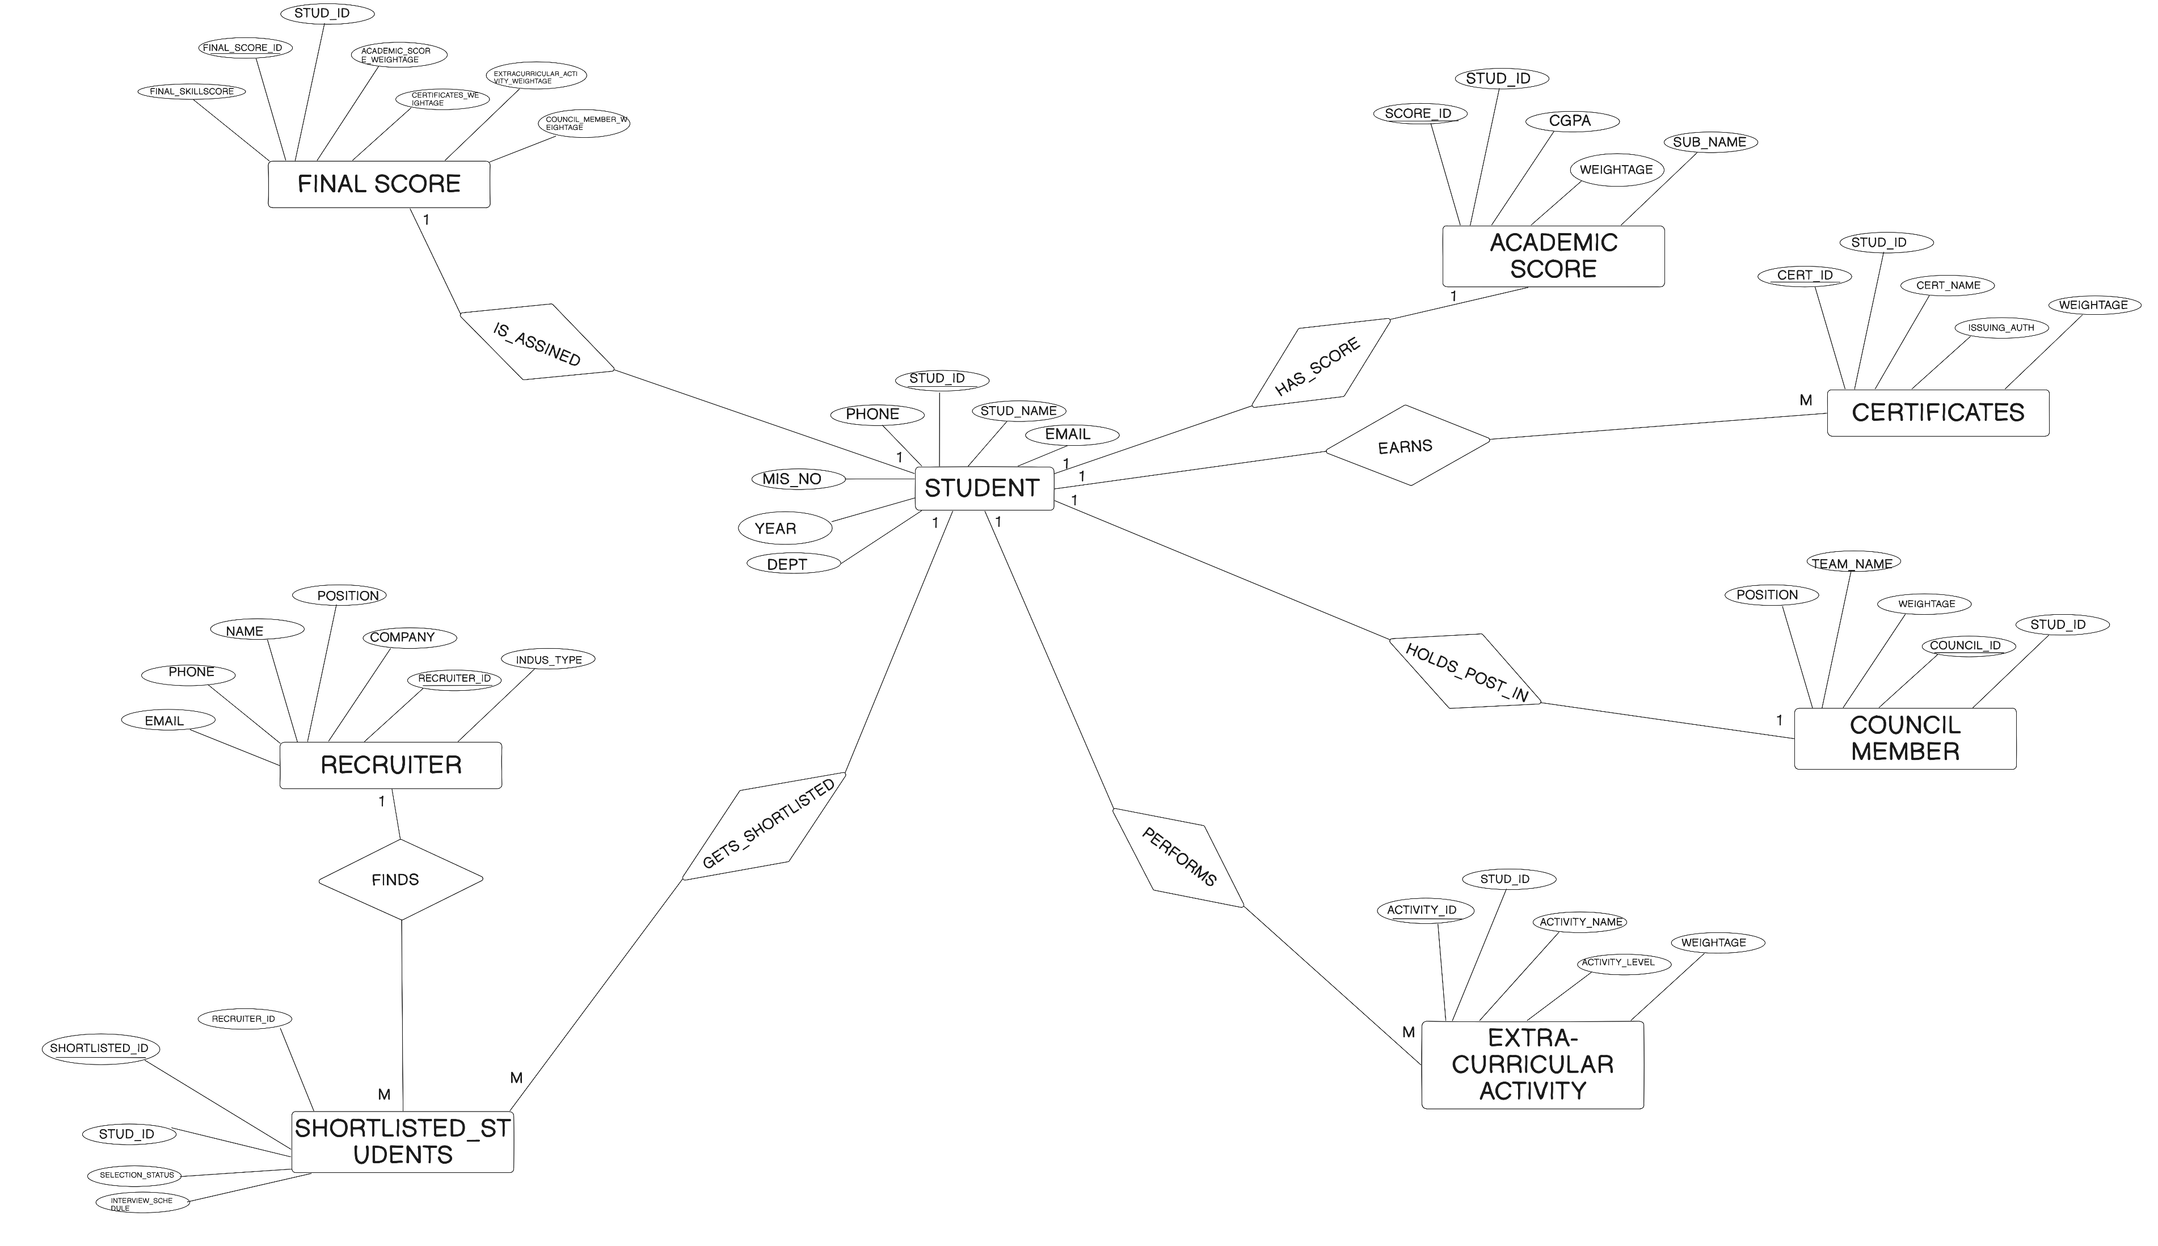
ER DIAGRAM

Slide 15
USE CASE DIAGRAM

Slide 16
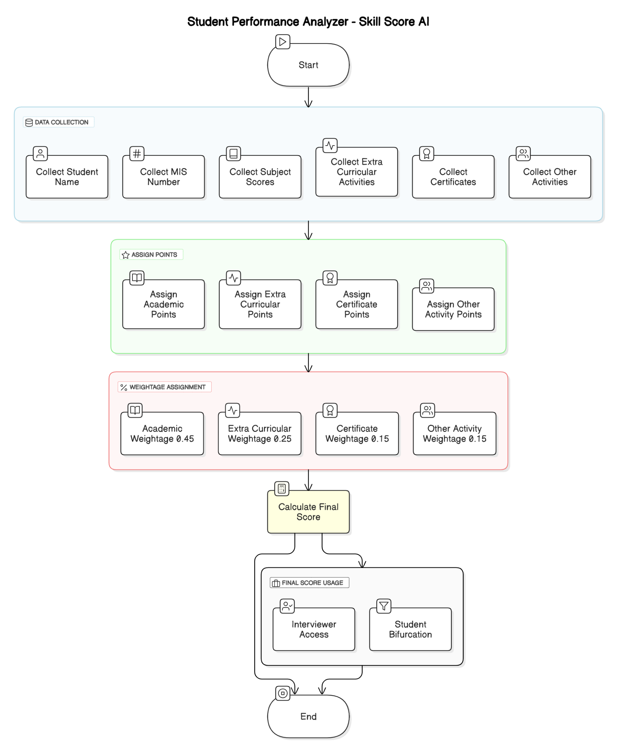
FLOW DIAGRAM

Slide 17
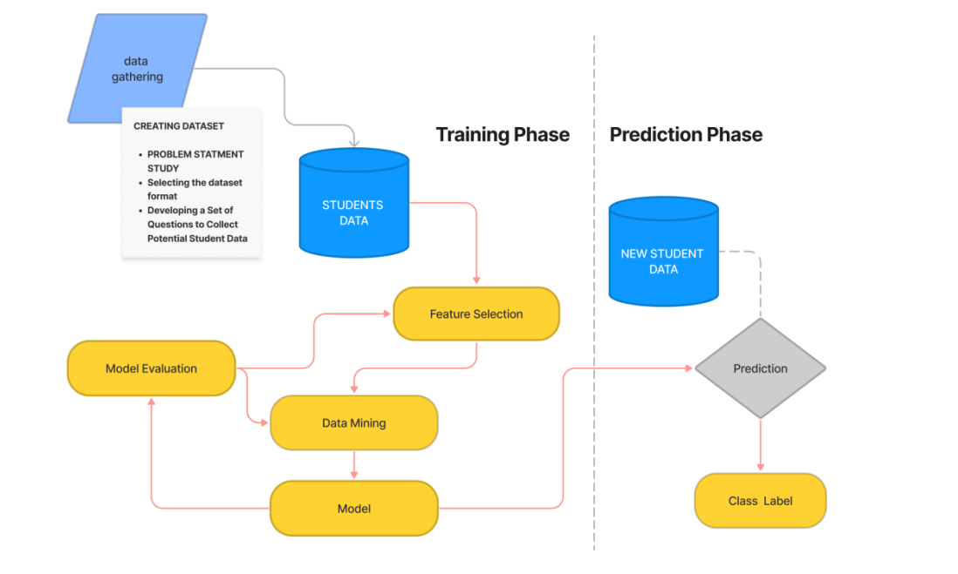
SYSTEM ARCHITECTURE DESIGN

Slide 18
FLOW DIAGRAM
BENEFITS
AI based performance scoring
Recruiter dashboard and filters
Holistic student evaluation
Real-time ranking system

Slide 19





TECHNOLOGY STACK
FLOW DIAGRAM

Slide 20
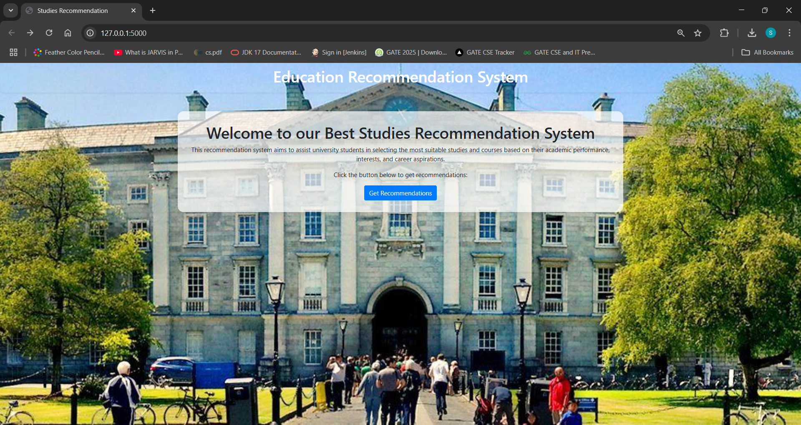
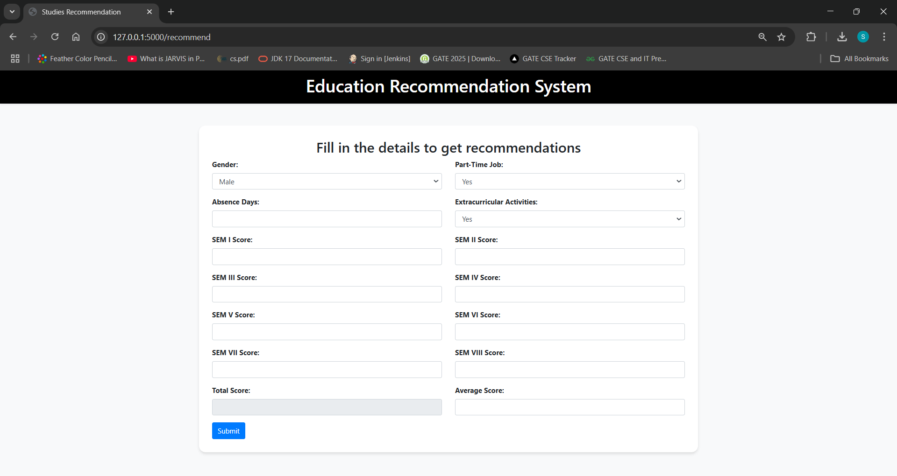
FLOW DIAGRAM
FRONT END

Slide 21
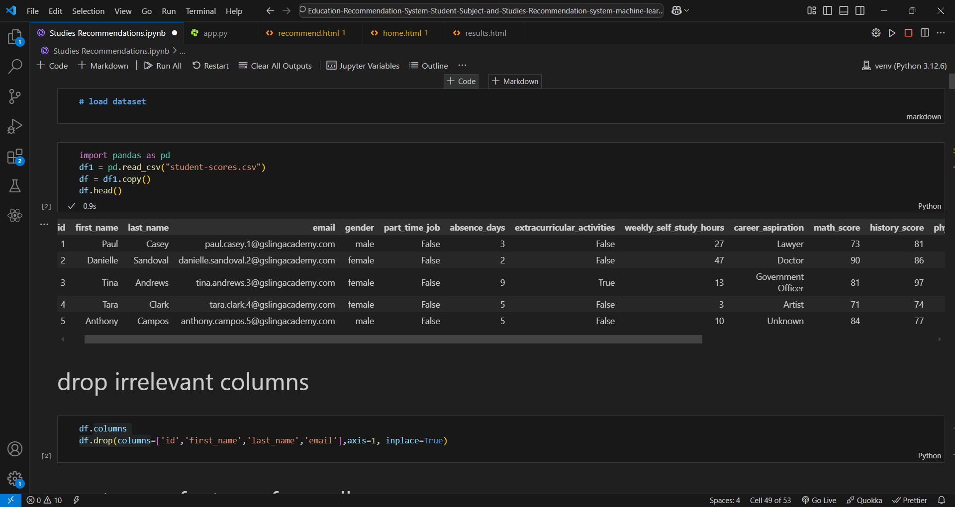
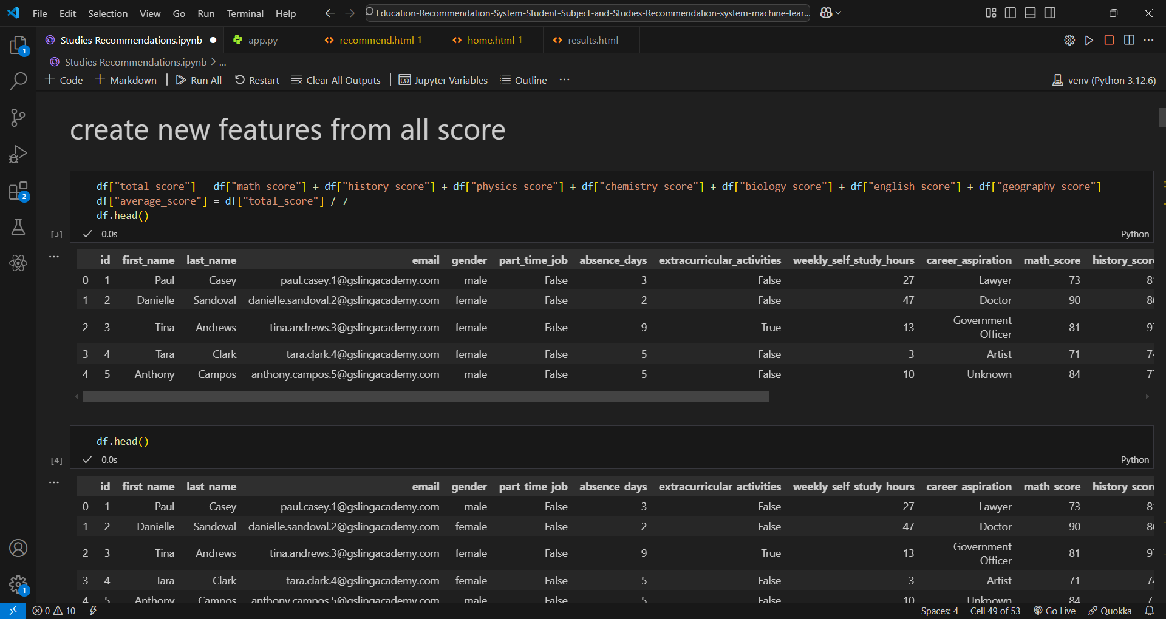
BACK END

Slide 22
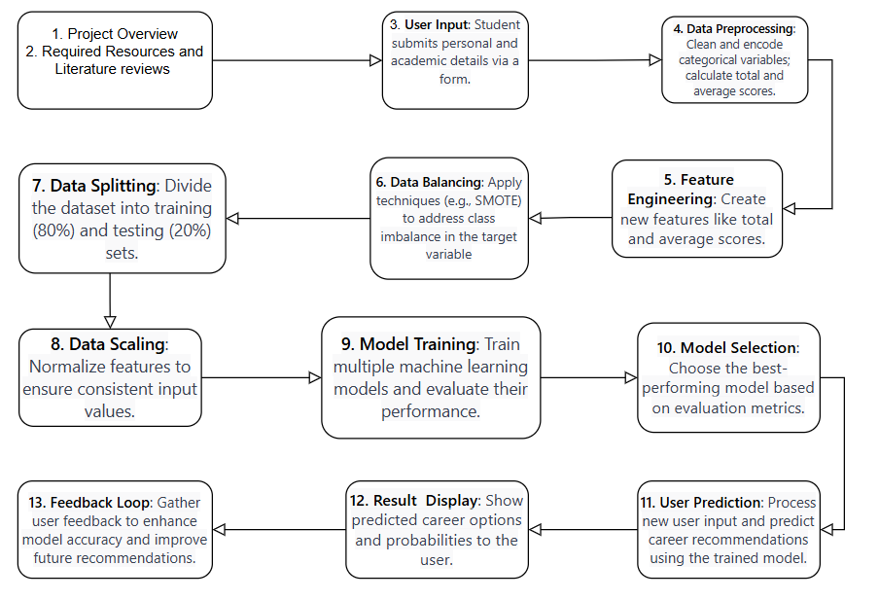
Work Flow Diagram

Slide 23
Future Inventions
AI-Based Career Guidance
Skill Gap Analysis & Training SuggestionsDetailed Analytics and Reporting
Gamification & Rewards System
Real-Time Industry Insights

Slide 24
FLOW DIAGRAM
CONCLUSION
Skill Score AI is a game-changing student performance analyzer that provides a holistic evaluation by integrating academic achievements, extracurricular activities, and leadership roles into a single AI-powered score.
With an intelligent ranking system and recruiter-friendly dashboard, our platform simplifies the shortlisting process for companies, making hiring efficient and data-driven.
This system not only benefits recruiters but also helps students identify their strengths and areas for improvement, ultimately enhancing career opportunities.

Slide 25
REFERENCES
Kotagiri Sanjana et al. (2023) “Student Performance Analysis Using Machine Learning”
Shikha Pachouly et al. (2022), “Student General Performance Prediction Using Machine Learning Algorithm”
Prakash, Sachin Garg (2021), “Performance Analysis and Prediction of Student Result Using Machine Learning”
Charalampos dervenis, Panos fitsilis, Spyros Stoufis, “Predicting Students' Performance Using Machine Learning Algorithms”
Atul Prakash Prajapati et al. (2017), “Student Performance Analysis Using Machine Learning Tools”
FLOW DIAGRAM

Slide 26
BACK END
FLOW DIAGRAM
Thankyou

